Slide 1
Flow Aware Networking
Router model
lead by prof. dr hab. inż. Andrzej Jajszczyk

Slide 2
Outline
Transmission requirements
QoS
Existing architectures (IntServ, DiffServ)
FAN mechanisms
Cross-protection: MBAC
Conclusion

Slide 3
Outline
Transmission requirements
QoS
Existing architectures (IntServ, DiffServ)
FAN mechanisms
Cross-protection: MBAC
Conclusion

Slide 4
Current network quality requirements
Nowadays networks are expected to support a variety of services beyond the best-effort service available today
New applications already rely on the network ability to guarantee such services
High speed packet-switched networks
Applications requiring
bandwidth
Applications requiring
low latency
P2P Networks, Large Databases,
Large multimedia files,
XBOX Live
VoIP, tele-conferencing,
UMA, on-line gaming,
distance learning
Notes:
Near-future high-speed packet switched networks are expected to support large variety of services far beyond the best-effort service available today. New applications such as VoIP, distance learning or PeerToPeer rely on ability of the network to guarantee different types of services. For example on-line gaming would expect the network to ensure that each flow of traffic receives its fair share of the bandwidth and is able to provide guarantee that delay between players will not exceed earlier specified limit. On the other hand there are services that don’t require any special latency limits – however they require as much bandwidth as possible. The good example would be Xbox Live from Microsoft – where one can download game content and music/movies directly to one’s console.
What is the operation of such services in best-effort Internet?
Low quality VoIP calls, often impossible to easily communicate, or problems such as the one from US Xbox live users – that needed to wait at least 10 hours to see the movie they decided to buy.
The future applications require working Quality of Service solution to efficiently manage and divide shared resources among competing users. There is no other way to solve the problem of congestion.

Slide 5
What is congestion?
Simple definition: congestion occurs when traffic coming into one link exceeds its capacity e.g. motorway
Main reason: lack of bandwidth
  Demand bigger than capacity
  Suddenly changing demands
  Network failures
  Changes in routing
Notes:
Congestion occurs when traffic coming into one link exceeds its capacity. If one has problems with understanding congestion – one should drive the main city streets at rush hours.
Congestion is a result of everlasting problem – demand is greater than supply – in telecommunications the requested resource is bandwidth. Nowadays core networks still have very high redundancy of capacity – the problem typically occurs where multiple links feed into a single link, such as internal LANs are connected to WAN links.
The reason for congestion may also be suddenly changing demands – as an example we could take VoIP – new technologies require new traffic quality – and some of the networks were not designed to be reconfigurable or were limited to one type of service – e.g. HTTP.
Although core networks still have redundancy, in case of failures or relevant changes in routing they may have congestion problems – backbone links serve in such a situation more traffic than they were supposed to – sometimes the amount of information sent is few times bigger.

Slide 6
Outline
Transmission requirements
QoS
Existing architectures (IntServ, DiffServ)
FAN mechanisms
Cross-protection: MBAC
Conclusion

Slide 7
QoS
In streaming traffic type following guarantee an end-user proper:
Packet delay
Mean bit rate
Stream bit rate
Packet loss
Jitter

Slide 8
Outline
Transmission requirements
QoS
Existing architectures (IntServ, DiffServ)
FAN mechanisms
Cross-protection: MBAC
Conclusion

Slide 9
What are the current QoS solutions?
New Idea:
Flow Aware Networking
Already Implemented:
Integrated Services – IntServ, the first model defining whole concept of QoS
Differentiated Services – DiffServ – later conception, opposite (in majority) to IntServ
Notes:
There are two QoS solutions already created and implemented inside hardware. Both are the result of IETF works, however there are few years of difference between their creation date.
IntServ was the first concept to enhance the model of Internet with management and division of available bandwidth in data links, based on flows classification and explicit resources reservation. However it was immature, and it showed off that it is rather impossible to implement in whole internet.
The second concept was DiffServ, opposite (as mentioned before) to IntServ. It managed to overcome its predecessor problems in scalability at the expense of some restrictions in its features. DiffServ presented the idea of no resources reservation and QoS classification based on aggregates. Although it is a mature model, due to some disadvantages it is also not commonly used.
FAN is the next generation model, whose main attitude is to take the best features from both models and avoid their main disadvantages. Its idea comes from France Telecom R&D team.
So what are the main differences between IntServ and DiffServ – you will see on next slides.

Slide 10
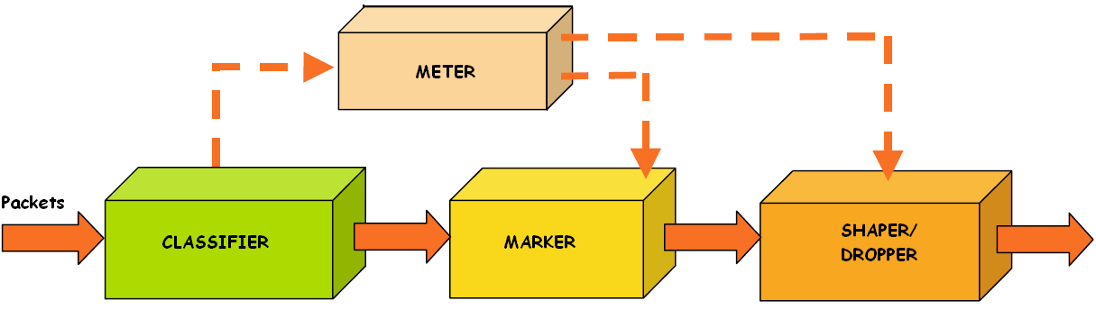
Traffic conditioning mechanisms
Notes:
Traffic conditioning mechanisms perform 4 types of operation:
a.) metering
b.) marking
c.) shaping
d.) dropping
The aim of the monitoring is to check if selected packet flow is compliant or non-complaint with assumed profile.
Packet marking may be performed on packet coming directly from classifier block, or on a packet coming from meter block.
The aim of this step is to set proper value of header fields, which are designed to hold that information. In case of DiffServ, marking means setting correctly DSCP fields in packet header. This allows packets to be served in proper way on every next level of service.
The last traffic conditioning block is shaper/dropper – its mechanisms allow to remove packets from network, which are not complaint with their declared traffic profile or which removal may influence and change traffic generated by packets source. In both cases the shaping/dropping process should support requirements specified for selected service in QoS.
The next step for all packets are scheduling mechanisms.

Slide 11
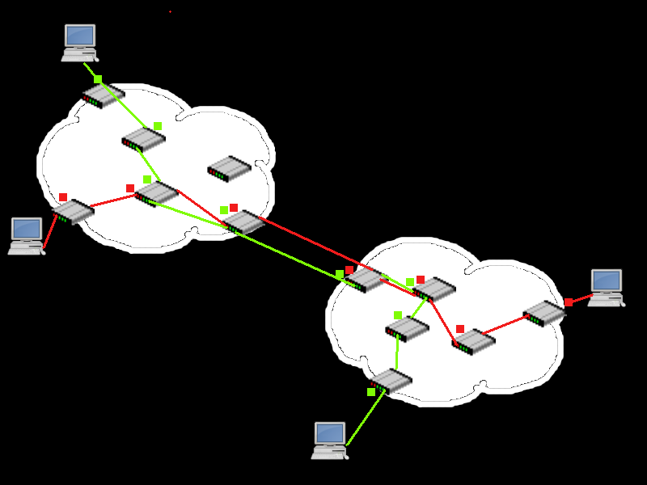
IntServ
Memory load
High
High
Low

Slide 12
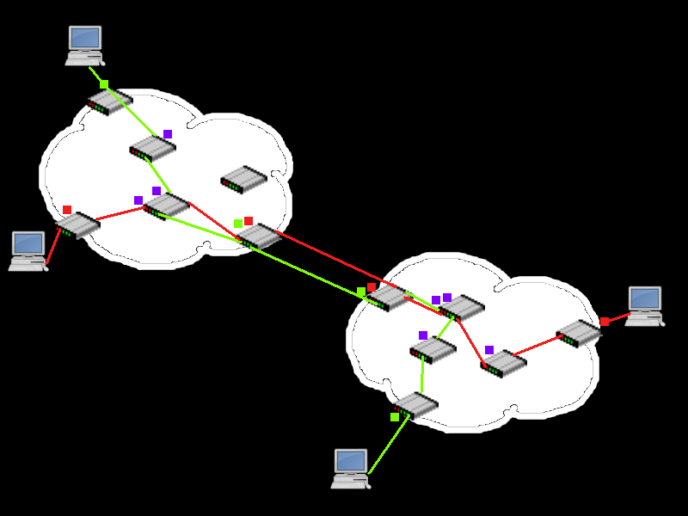
DiffServ
Memory load
High
High
Low

Slide 13
How does congestion control is implemented in DiffServ?
QoS Mechanisms
Packet level
Admission level
classifier
AC (admission control)
traffic conditioners
scheduler
Network traffic entering a DiffServ domain is subjected to classification and conditioning
AC realized only in edge routers, controlled by Bandwidth Broker
PHB define packet forwarding properties inside domain
Notes:
Congestion control is realized in DiffServ by standard QoS mechanisms. They can be divided into 2 groups:
a.) packet level control
b.) admission level control
In DiffServ as we mentioned before – large part of QoS mechanisms is used only in edge routers. First example is admission control, controlled by Bandwidth Broker. It is an DiffServ domain agent that has some knowledge of an organization's priorities and policies and allocates bandwidth with respect to those policies. The second type of mechanisms located only in edge routers is classification and traffic conditioning.
Classification mechanisms consist of aggregates, which perform filtering of incoming packets – e.g. they assign packets to predefined network services, according to selected IP header fields. Applicable filtering elements divide packets into matching and non-matching to accepted filter model. According to performed selection packets are assigned proper class of traffic. As we mentioned before all DiffServ aware routers implement Per-Hop Behaviors (PHBs), which define the packet forwarding properties associated with this class of the traffic.

Slide 14
Main differences between IntServ and DiffServ
Parameter
IntServ
DiffServ
Coordination for service differentation
End to end
Per hop
Classification of traffic
Limited by number of flows
Limited by number of classes of service
Network accounting
Based on flow characteristics and QoS requirement
Based on class usage
Network management
Similar to network switching (e.g. phone calls)
Similar to IP networks
Inter domain deployment
Multilateral agreements
Bilateral agreements
Quality guarantees
Per flow - bandwidth and delay guarantee
Cannot provide low delay and high bandwith guarantee simultaneously
Scalability
Information held in each network node – not scalable
Scalable and robust
Notes:
The slide presents main differences between IntServ and DiffServ.
In IntServ the resources are overtly reserved in each router of the network path before beginning the transmission – traffic requirements have to be explicitly specified. The classification is based on flows – each of them has its bandwidth and delay guarantee – what is especially important in VBR, CBR traffic types – e.g. VoD. This type of QoS is good for short-lived reservation, when high resource utilization is required. However it is not scalable – each network node needs to hold an information about network state.
DiffServ shows totally opposite approach - it operates on the principal of traffic classification, where each packet is qualified into one of the classes; rather than differentiating network traffic based on the requirements of an individual flow
(IntServ). Each traffic class is managed in a different way – depending on its requirements – e.g. low latency or assured bandwidth – however you cannot assign packet to 2 traffic classes. There is no information about individual flow in each network node – the design is more scalable and robust. Admission control is performed only DiffServ domain endpoints.

Slide 15
Outline
Transmission requirements
QoS
Existing architectures (IntServ, DiffServ)
FAN mechanisms
Cross-protection: MBAC
Conclusion

Slide 16
Features of FAN
No reservation
Classification based on flows
2 flow classes - stream (audio, video, real-time) and elastic (digital documents)
Idea of cross-protect router – accurate relation between admission control and scheduling
“Good enough” performance
Cost effectiveness and accountability $$$
Notes:
The main features of FAN show us that it really takes the best from both previous architectures. There is no resources reservation before start of transmission – all the flows are identified on the fly – there is no additional signaling.
Traffic classification is based on flows – there are only 2 types of them:
a.) stream – assigned to all real-time audio, video, playback transmission, and all the traffic that will require small delays and low packet loss.
b.) elastic – assigned to Web pages, mail, files, stored video – these flows will share the rest available bandwidth (fairly and efficiently)
“Good enough” performance means that the performance guarantees of FAN are probabilistic. A streaming flow of low peak rate is assured low packet loss and delay. Loss probability and delay, as well as the maximum peak rate, may be controlled by appropriately defining admission control criteria.
The idea of cross-protect is the main notion of FAN – it applies Measurement Based Admission Control – the control and identification of link usage and saturation is done dynamically by scheduler and it is forwarded to admission control block, so it can decide if the new incoming packets should be serviced or dropped off.
The last feature is about money - FAN would enable greater cost effectiveness by allowing more efficient capacity planning. This derives from the insurance provided by admission control: quality and efficiency are assured even in the event of overload.

Slide 17
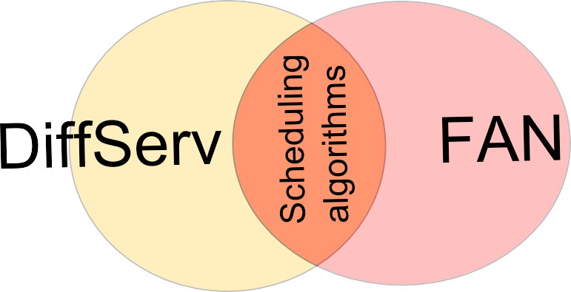
What DiffServ congestion control ideas have in common with FAN?
The only common mechanisms are admission control and scheduling, but the admission control is realized in different way
Scheduling algorithms may be implemented in FAN
There are many elementary conceptions common to both architectures – but these are mostly basics of QoS idea
Notes:
On the basis of information from previous slide we can conclude that the only common space for FAN and DiffServ is scheduler block. The admission control is implemented in both architectures but in DiffServ it is built in a central way (Bandwidth Broker with edge routers), and in FAN it is distributed among every router. The second difference is that one architecture uses aggregates and the second one flows as a method of QoS traffic classification. The differences are too major to search for simple solution transition from one to another.
The second block implemented in both designs is scheduler. Of course we cannot copy entire block – the simplest reason is different traffic classification – but we can think about transition of queue management and scheduling algorithms. In the following slides we will describe two scheduling algorithms, that may be implemented in FAN. First one is Priority Fair Queuing and the second one is Pre-Order Deficit Round Robin. But first we will concentrate on the idea MBAC and cross-protect router.
Of course we cannot forget that there are many others, minor details that are (or may be, as FAN concept is not yet complete) common to both solutions. However we will not cover such details in this presentation.

Slide 18
Outline
Transmission requirements
QoS
Existing architectures (IntServ, DiffServ)
FAN mechanisms
Cross-protection: MBAC
Conclusion

Slide 19
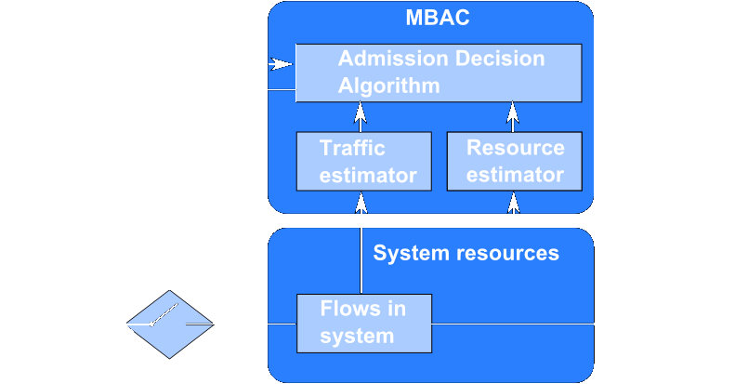
Measurement Based Admission Control (MBAC)
Notes:
In FAN networks, Admission Control in each node secures the proper conditions for every already registered flow in case of congestion. All the decisions about new incoming flows are made in this block – whether to service or reject requesting flow. Every flow, serviced currently by router is registered on special list – called PFL (Protected Flow List). If requesting flow is already on the list, all of its packets are serviced instantly, if not the admission decision algorithm is performed. If the link is currently under congestion and transfer of new incoming packets is impossible, then the flow is rejected. If the link is free (have enough bandwidth to service new flow), then it is accepted and added to PFL. This is also the way user gets information about congestion in network – in such a case his request for new flow is rejected.
But what about small amounts of data held in each router that we have talked about before? Is the PFL not getting bigger and bigger with each incoming flow? To prevent that situation, all the flows are monitored. If there is no packet with id from given flow for a while, then it is removed from the list.
There is still one more question about the way the router monitors links saturation. It is done actually by Scheduler block.

Slide 20
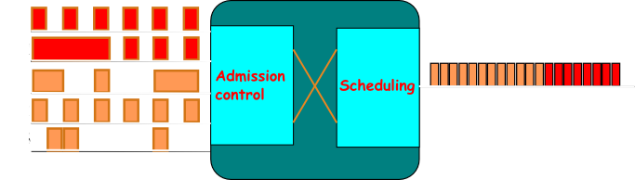
Cross-protection in FAN router
Incoming packets
Outgoing packets
Notes:
The implementation of both Admission Control and Scheduling mechanisms assures differentiation of quality for 2 types of traffic that are described in FAN. Measurements of link utilization are performed in a constant way in Scheduler part. All the decisions about accepting new flow are made on the basis of this link utilization and bandwidth per one flow in current PFL (which is also measured in scheduling block).
This way both mechanisms are strictly dependant – Admission Control block uses data from Scheduler to monitor the probability of packet loss, possible packet delay, and also the maximum bandwidth for the flow to be treated as stream. Scheduling provides also the AC block with the measurements of fair bandwidth – this is connected with proposed by the authors of FAN scheduling algorithm, called Priority Fair Queueing, which differentiates flows by their bandwidth – if it is bigger or lower than fair value.
This algorithm will be described and explained in the following slides.

Slide 21
Outline
Transmission requirements
QoS
Existing architectures (IntServ, DiffServ)
FAN mechanisms
Cross-protection: MBAC
Conclusion

Slide 22
FAN – pros and cons…
Advantages | Disadvantages
Good scalability Ease of admission control in each network node (MBAC) Only small amounts of data stored in network node memory | No strict guarantees of network performance Not implemented yet
Notes:
The features presented on the previous slide result in the following advantages and disadvantages. The main amenity of FAN is scalability – up till now no solution was really implemented in Internet to be the standard of QoS. With FAN it is more possible, while the information held in network nodes is very small, and design not complex, what should result in lower hardware costs and easier implementation.
The second advantage is MBAC, mentioned in the previous slide – this solution will allow router to properly estimate bandwidth requirements and identify current link situation. Additionally there is no need to transfer and hold additional information about link SLA in each node – and this is the 3rd advantage – amount of data stored is much smaller then in previous design. This results in simpler hardware design.
The main disadvantage is a lack of any strict network performance guarantee (as e.g. in IntServ). It is possible that in some rare situations the link capacity guarantee won’t be fulfilled – however it may be adjusted by specifying proper parameters.
The second disadvantage is quite simple – there is no ready implementation of hardware router – the only results we have are from simulations and calculations, the reality may be different.

Slide 23
Thank you for attention!
to be continued…

